Slide 1
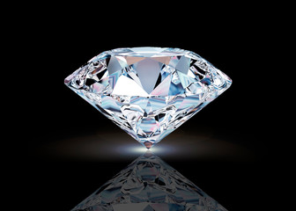
Diamond Price Prediction Analysis
Presented By : S GEETA
MIRZA SHAHNAWAZ BAIG
HIMANSHU SHARMA

Slide 2
Problem Statement:
The problem to be investigated in this study is to predict the price and carat of the diamond using machine learning and various regression models have been trained.

Slide 3
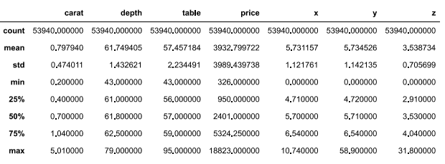
Introduction:
Diamond is known with their hardness ,good thermal conductivity ,and high index of refraction. Colour and Clarity determine the price of diamond to be selected as a jewellery gems. Gem Stones like diamond are always in demand because of there value in the investement market .we have taken a dataset as shown below.

Slide 4
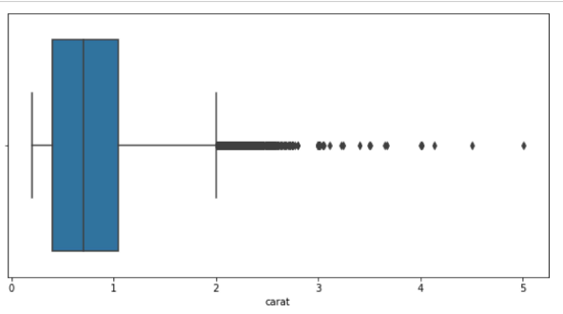
Exploratory Data Analysis:
Boxplot Analysis
Box plot is used to show distributions of numeric data values, especially when u want to compare them between multiple groups.

Slide 5
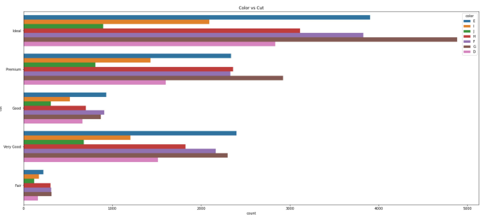
Count plot Analysis
The count plot is used to represent the occurrence(counts) of the observations present in the categorical variable .It uses the concept of bar chart for the visual depiction. It shows the comparision of different groups in categorical variables.

Slide 6
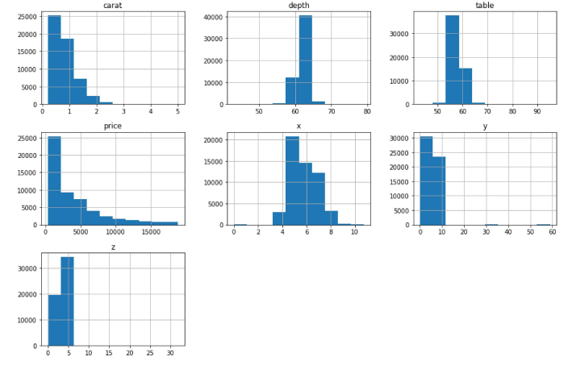
Subplot Analysis
A subplot is uesd for displaying dense information in data visulization. It provides a way to plot multiple plots on a single figure. It is used for displaying the dense informaton.

Slide 7
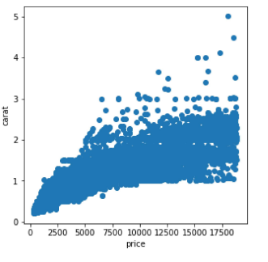
Scatterplot Analysis
Similarly, we can see the data visualization technique that shows the relationship between two numerical variables that are Carat and Price.

Slide 8
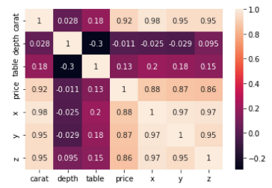
Heatmap Analysis
If the value is 1, it is said to be a positive correlation between two variables. This means that when one variable increases, the other variable also increases.
If the value is -1, it is said to be a negative correlation between the two variables. This means that when one variable increases, the other variable decreases.
If the value is 0, there is no correlation between the two variables. This means that the variables changes in a random manner with respect to each other.

Slide 9
Methodology:
Here we have used one Machine Learning Algorithm, which are part of Supervised Learning
Random forest Regression
.
Random forest regression is a Supervised learning algorithm and bagging technique that uses an ensemble learning method for regression in machine learning .it is popularly used classification and regression problems.

Slide 10
Inferences:
We have drawn some inferences from the data frame. Here is a summary of a few of them:
Gemstones like diamond are always in demand because of their value in the investement market .
The most important variable is likely to be weight or width . An Exploratory data analysis reveals the relationship between carat and price to be non - linear
* Colour, Clarity, Carat, Shape, are the major determinants of the price of diamonds.

